Slide 1
Hardware & Environment Setup
Device images

Slide 2
Requirements
01 Raspberry Pi with updated operating system.
02 Microphone to record audio.
03 Speaker to play voice responses. 04 Internet connection.
05 OpenAI and Google Cloud accounts to get the necessary API keys.

Slide 3
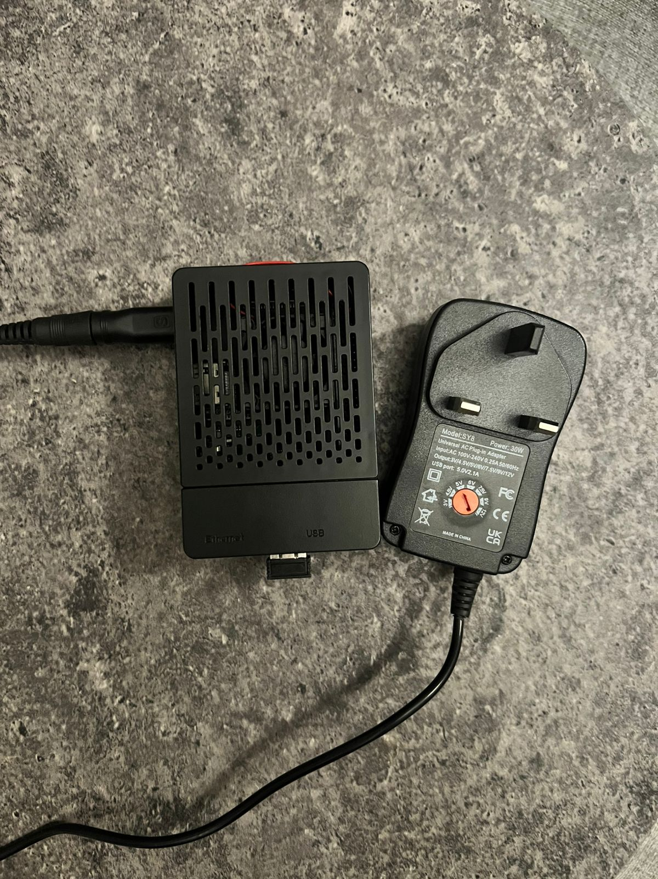
Raspberry Pi
single-board computers made by the Raspberry Pi Foundation allowing you to control electronic components for physical computing and explore the Internet of Things (IoT).

Slide 4
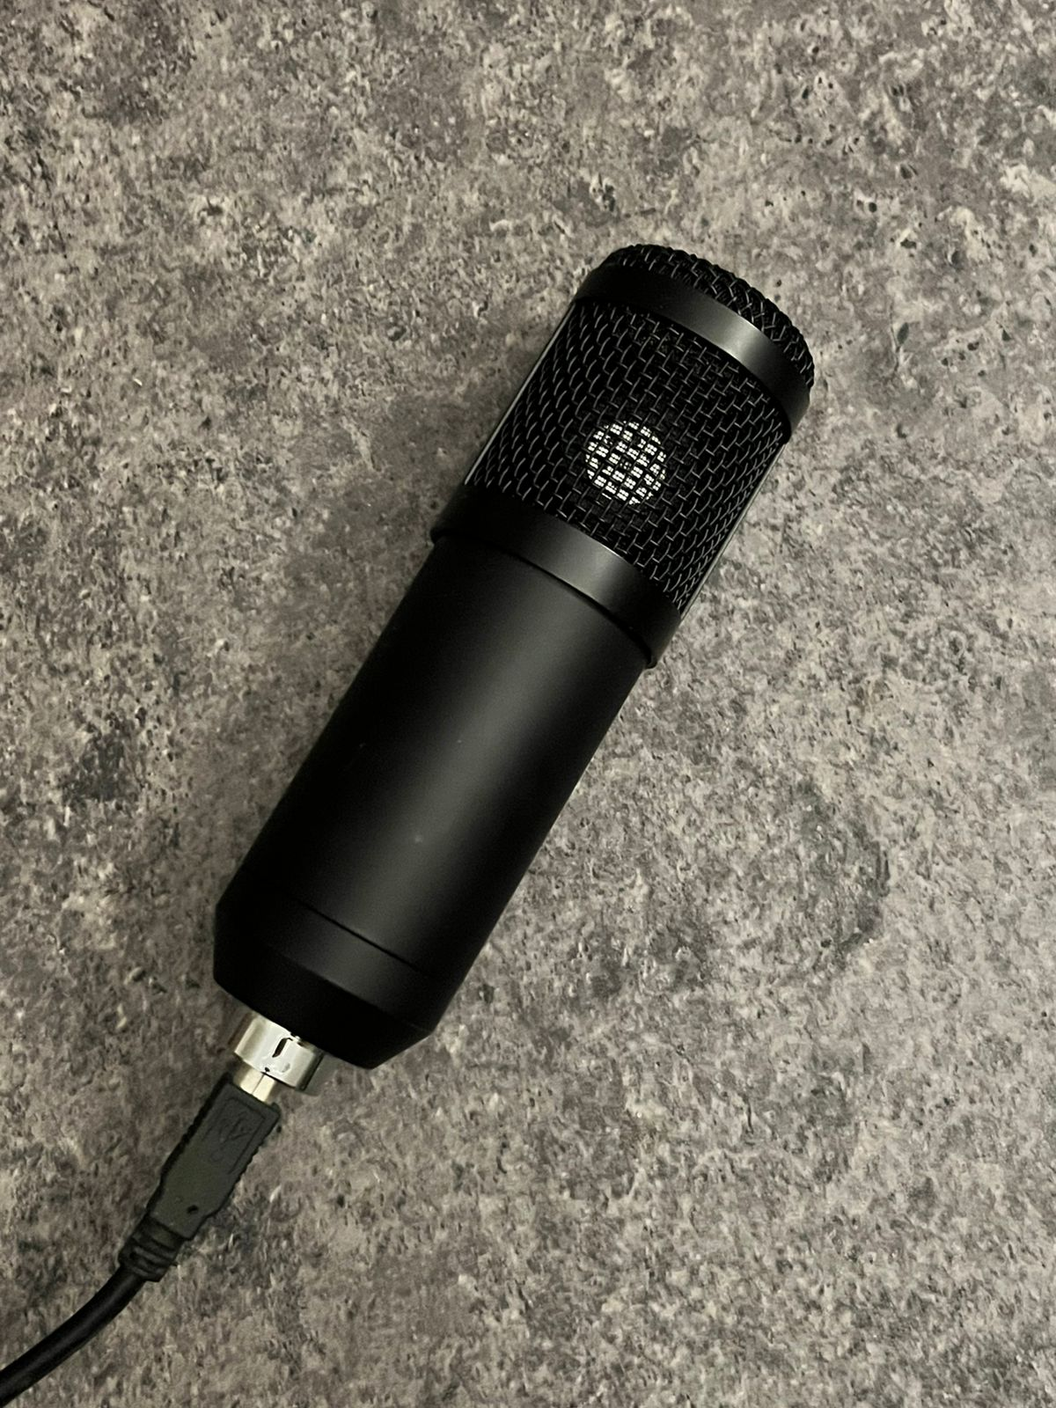
Microphone to record audio

Slide 5
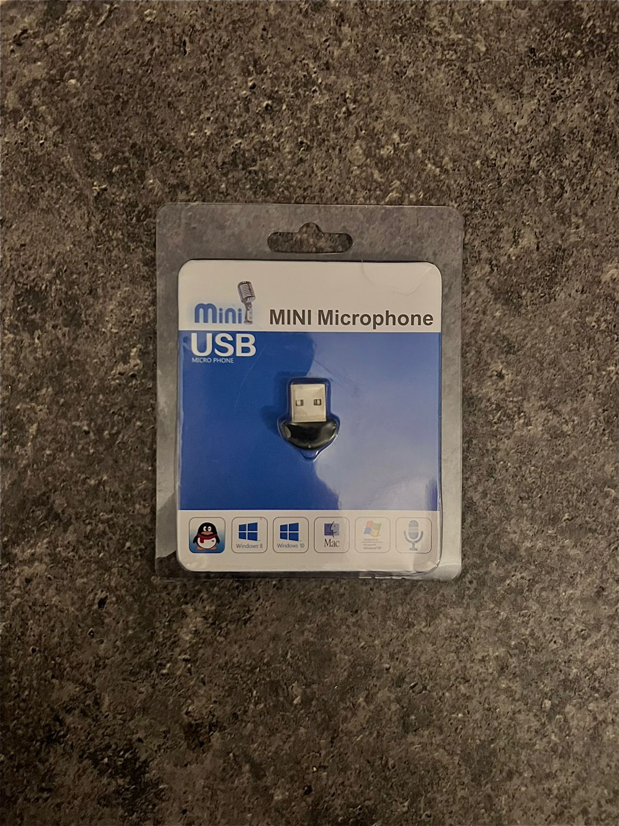
Speaker to play voice responses

